Slide 1
Cranial Nerves
NSC 4130 Lab 9

Slide 2
Roman Numerals
1 = I, 2 = II, 3 = III
4 = IV, 5 = V, 6 = VI, 7 = VII, 8 = VIII,
9 = IX, 10 = X, 11 = XI, 12 = XII

Slide 3
What are they?
Cranial nerves are the nerves that emerge directly from the brain
Relay information between the brain and parts of the body, primarily to and from regions of the head and neck
Come in pairs and can be found on both sides of the body

Slide 4
12 Cranial Nerves
1-olfactory nerve
2-optic nerve
3-oculomotor nerve
4-trochlear nerve
5-trigeminal nerve
6-abducens nerve
7-facial nerve
8-vestibulocochlear nerve
9-glossopharyngeal nerve
10-vagus nerve
11-accessory nerve
12-hypoglossal nerve
Notes:
12 cranial nerves, numbered based on the order in which they emerge from the brain, front to back (I-XII)

Slide 5
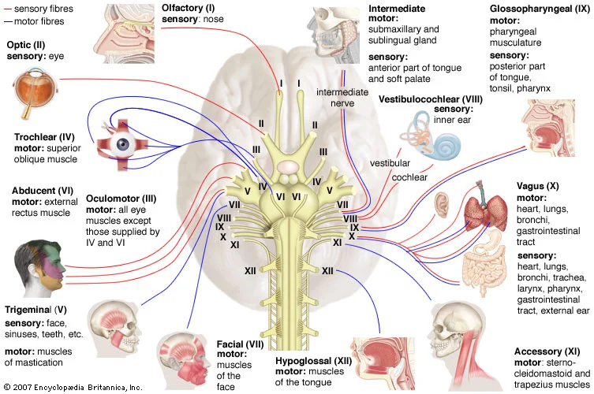

Slide 6
Activity: Create a mnemonic device
1-olfactory nerve
2-optic nerve
3-oculomotor nerve
4-trochlear nerve
5-trigeminal nerve
6-abducens nerve
7-facial nerve
8-vestibulocochlear nerve
9-glossopharyngeal nerve
10-vagus nerve
11-accessory nerve
12-hypoglossal nerve

Slide 7
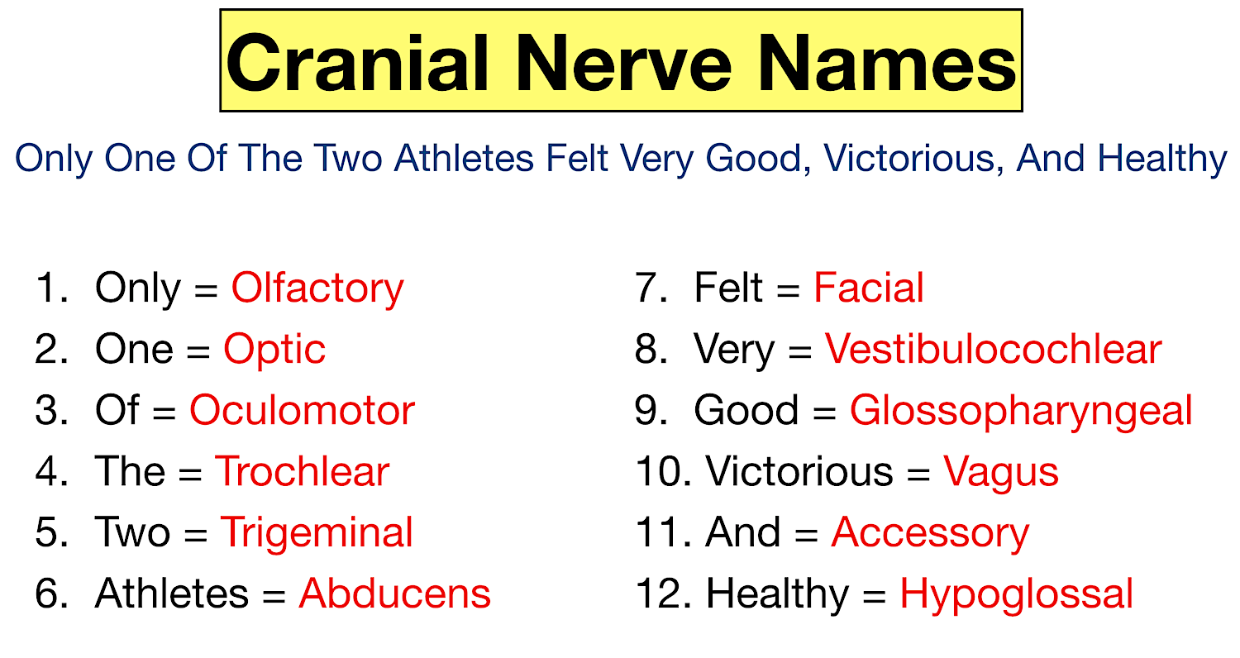

Slide 8
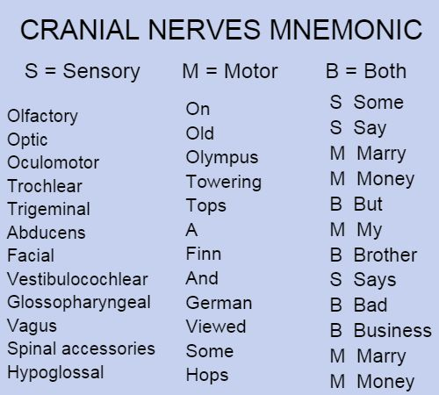

Slide 9
6 Major Cranial Nerve Categories
Motor Neurons
  Somatic – voluntary muscle control
  Branchial – Motor innervation to the muscles of the pharyngeal arches in humans
  Visceral – Motor innervation of smooth muscle, cardiac muscle, and glands
Sensory Neurons
  Visceral – conduct sensory impulses from the internal organs, glands, and blood vessels to the CNS
    Mostly pain or reflex sensations
  General – conduct impulses of pain, touch, and temperature from the surface of the body
    Also, impulses of muscle sense, tendon sense, and joint sense from the deeper structure
  Special – carry sense of smell (olfaction) and taste (gustation)

Slide 10
Activity: 6 Major Cranial Nerve Categories
Motor Neurons
  ________ – voluntary muscle control
  ________ – Motor innervation to the muscles of the pharyngeal arches in humans
  ________ – Motor innervation of smooth muscle, cardiac muscle, and glands
Sensory Neurons
  _______ – conduct sensory impulses from the internal organs, glands, and blood vessels to the CNS
    Mostly pain or reflex sensations
  _______ – conduct impulses of pain, touch, and temperature from the surface of the body
    Also, impulses of muscle sense, tendon sense, and joint sense from the deeper structure
  _______– carry sense of smell (olfaction) and taste (gustation)
Word Bank: Special , Somatic, General, Visceral, Visceral, Branchial

Slide 11
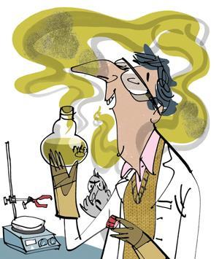
Cranial Nerve I – The Olfactory Nerve
Special sensory nerve
Conveys the sense of smell
Damage can cause an inability to smell (anosmia), a distortion to smell, or a distortion / lack of taste
Notes:
https://www.nature.com/articles/d41586-022-01627-w

Slide 12
Cranial Nerve II – The Optic Nerve
Special sensory nerve
Transmits visual information
Damage affects specific aspects of vision depending on the location of the lesion
Notes:
https://www.statnews.com/2016/03/28/parkinsons-psychosis-nuplazid/
https://pubmed.ncbi.nlm.nih.gov/31808354/

Slide 13
Cranial Nerve III – The Oculomotor Nerve
Somatic motor and visceral motor nerves
Plays a role in eye movement, lens Contortion and pupil dilation
Damage can cause double vision (diplopia), inability to coordinate the movement of both eyes (strabismus), eyelid drooping (ptosis), and pupil dilation (mydriasis). One may also experience an inability to open the eye due to paralysis of the levator muscle

Slide 14
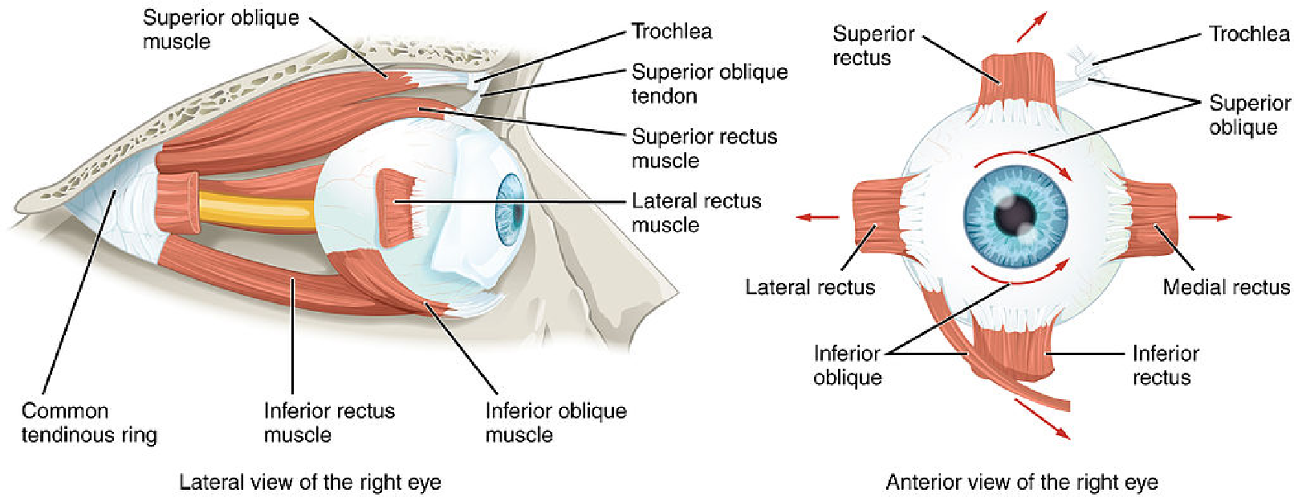
Cranial Nerve IV – The Trochlear Nerve
Somatic Motor Nerve
Also plays a role in eye movement
Superior oblique movement
Damage can also cause diplopia with the eye adducted and elevated (cannot move downwards)

Slide 15
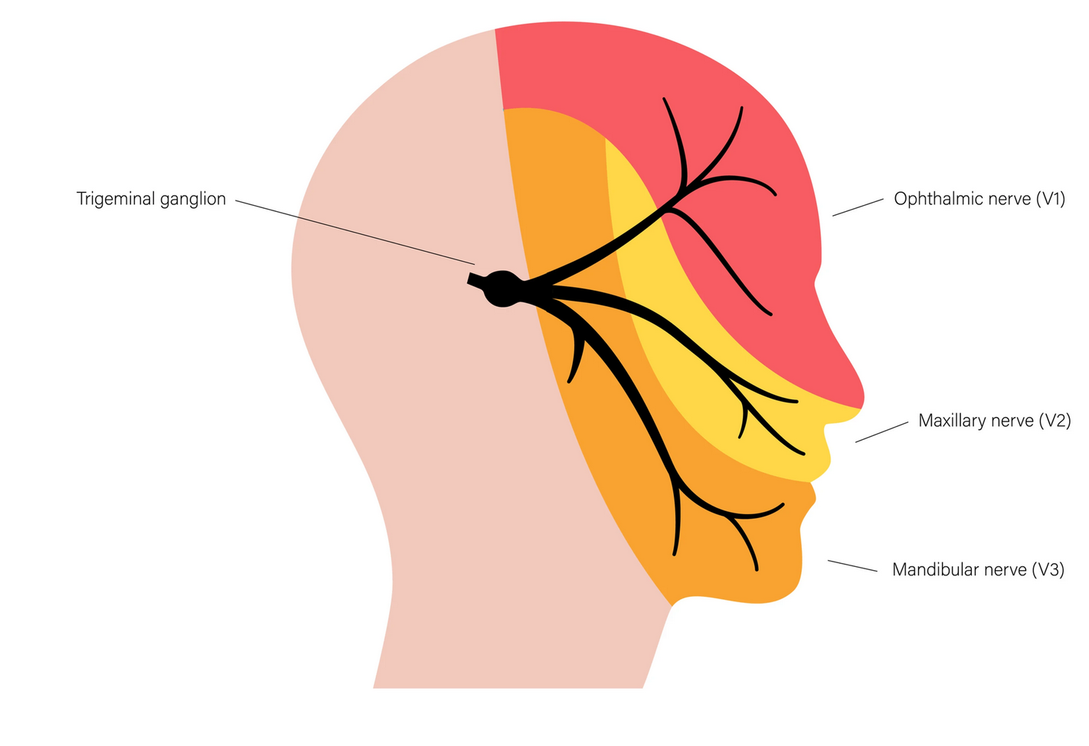
Cranial Nerve V – The Trigeminal Nerve
Branchial motor and general sensory nerves
Comprised of three distinct parts (V1, V2, and V3 nerves)
Control the muscles of chewing
Also provides somatic sensations from the face

Slide 16
Cranial Nerve VI – The Abducens Nerve
Somatic Motor Nerve
Lateral Rectus movement
Damage also results in Diplopia

Slide 17
Cranial Nerve VII – The Facial Nerve
Branchial motor, visceral motor, general sensory
Facial movement
Gland secretion
Taste – anterior 2/3 of tongue
General sensations from external ear tympanic membrane
Lesions may manifest a facial palsy
The most commonly injured cranial nerve in blunt trauma

Slide 18
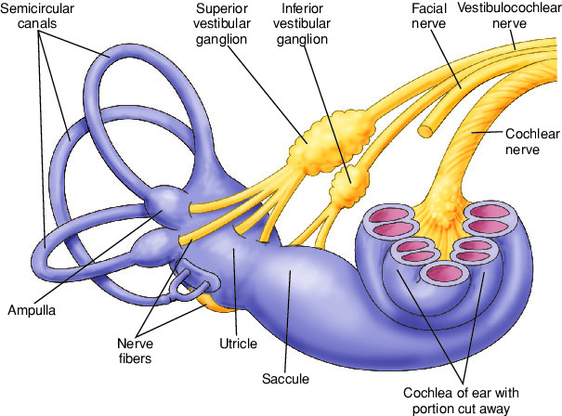
Cranial Nerve VIII – The Vestibulocochlear Nerve
Special Somatosensory Nerve
Splits into the vestibular and cochlear nerves
  Equilibrium and balance
  Ability to hear sound
Damage may give rise to the sensation of spinning and dizziness
May also case partial or complete deafness in the affected ear.

Slide 19
Cranial Nerve IX – The Glossopharyngeal Nerve
Branchial motor, visceral motor, visceral sensory, general sensory, special sensory
Swallowing
Sensations from carotid
Salivary gland secretion
Sensations of the tongue – posterior 1/3 of tongue
Unilateral absence of a gag reflex suggests a lesion

Slide 20
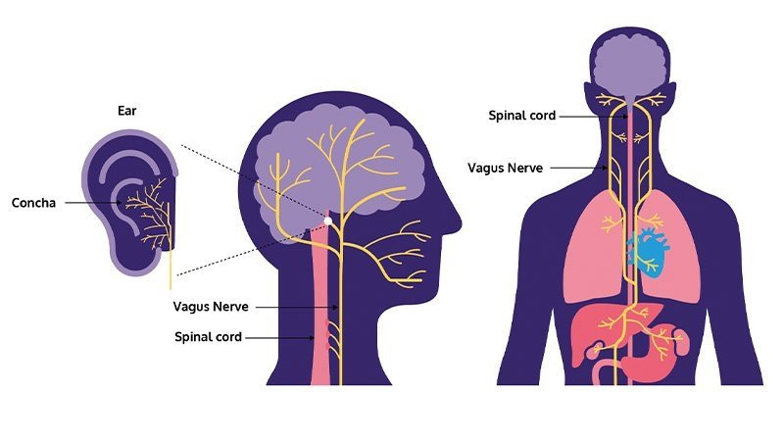
Cranial Nerve X – The Vagus Nerve
Branchial motor, visceral motor, visceral sensory, general sensory
Pharynx and larynx movement
Blood pressure control
Damage may cause trouble swallowing, as well as a rise in blood pressure and heart rate

Slide 21
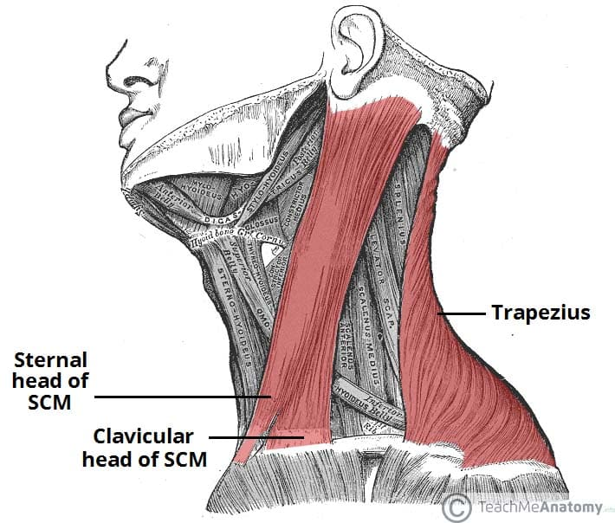
Cranial Nerve XI – The Accessory Nerve
Branchial motor
Sternomastoid and trapezius muscle
Winging of the scapula

Slide 22
Cranial Nerve XII – The Hypoglossal Nerve
Somatic motor nerve
Unique in that it is innervated from the motor cortices of both hemispheres of the brain
Tongue movement: swallowing, speech articulation
Damage may cause weakness or issues moving the tongue

Slide 23
Activity: Match the nerve to the function
Function
Taste, anterior 2/3 of tongue
Impulses from inner ear; equilibrium and hearing
Motor to sylopharyngeus muscle (swallowing)
PSNS supply to parotid (salivary) gland
Enable a vasoconstrictor response and increase blood pressure
Sensation from a small area around the external ear
Baroreceptors of the carotid sinus and chemoreceptors of the carotid body
Posterior 1/3 of tongue, tympanic membrane
Taste, posterior 1/3 of tongue
Motor to superior oblique
Motor to muscles of mastication
Vision
Innervates all the extrinsic eye muscles except superior oblique and lateral rectus
PSNS supply to ciliary and pupillary constrictor muscles
General sensation from external ear tympanic membrane
Innervate muscles of facial expression
PSNS supply to glands of head
Pharynx and larynx
PSNS supply to laryngeal and pharyngeal muscles and abdominal viscera
Motor to sternomastoid and trapezius muscle
Swallowing and speech articulation
Nerve
Optic
Olfactory
Oculomotor
Trochlear
Trigeminal
Abducens
Facial
Vestibulocochlear
Glossopharyngeal
Vagus
Accessory
Hypoglossal

Slide 24
Nerve | Number | Somatic Motor | Branchial Motor | Visceral Motor | Visceral Sensory | General Sensory | Special Sensory | Function
Olfactory | 1 |  |  |  |  |  | X | Smell
Optic | 2 |  |  |  |  |  | X | Vision
Oculomotor | 3 | X |  |  |  |  |  | Innervates all the extrinsic eye muscles except superior oblique and lateral rectus
 |  |  |  | X |  |  |  | PSNS supply to ciliary and pupillary constrictor muscles
Trochlear | 4 | X |  |  |  |  |  | Motor to superior oblique
Trigeminal | 5 |  | X |  |  |  |  | Motor to muscles of mastication
 |  |  |  |  |  | X |  | Somatic sensation from face
Abducens | 6 | X |  |  |  |  |  | Motor to lateral rectus
Facial | 7 |  | X |  |  |  |  | Innervate muscles of facial expression
 |  |  |  | X |  |  |  | PSNS supply to glands of head
 |  |  |  |  |  | X |  | General sensation from external ear tympanic membrane
 |  |  |  |  |  |  | X | Taste, anterior 2/3 of tongue
Vestibulocochlear | 8 |  |  |  |  |  | X | Impulses from inner ear; equilibrium and hearing
Glossopharyngeal | 9 |  | X |  |  |  |  | Motor to sylopharyngeus muscle (swallowing)
 |  |  |  | X |  |  |  | PSNS supply to parotid (salivary) gland
 |  |  |  |  | X |  |  | Baroreceptors of the carotid sinus and chemoreceptors of the carotid body
 |  |  |  |  |  | X |  | Posterior 1/3 of tongue, tympanic membrane
 |  |  |  |  |  |  | X | Taste, posterior 1/3 of tongue
Vagus | 10 |  | X |  |  |  |  | Pharynx and larynx
 |  |  |  | X |  |  |  | PSNS supply to laryngeal and pharyngeal muscles and abdominal viscera
 |  |  |  |  | X |  |  | Enable a vasoconstrictor response and increase blood pressure
 |  |  |  |  |  | X |  | Sensation from a small area around the external ear
Accessory | 11 |  | X |  |  |  |  | Motor to sternomastoid and trapezius muscle
Hypoglossal | 12 | X |  |  |  |  |  | Swallowing and speech articulation

Slide 25
Next Week
Bonus Quiz
  This quiz will consist of questions related to today’s lecture and will replace your lowest quiz grade
Catch-up Day
  Make up quizzes will be scheduled during this time

Slide 26
Bonus Points: +5 points on next quiz
Make a test with the materials you have learned today (with a test answer key)
Make a study guide
Make a quiz on quizlet
Make note cards with the material
Must include: Order of cranial nerves, cranial nerve categories and nerve function

